Slide 1

UNIVERSITY INSTITUTE OF ENGINEERING
COMPUTER SCIENCE ENGINEERING
Machine Learning
23CSH-651
By
Dr. Meena Pundir
INTRODUCTION
DISCOVER . LEARN . EMPOWER

Slide 2
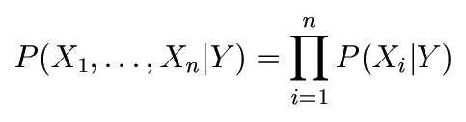
The Naïve Bayes Model
The Naïve Bayes Assumption: Assume that all features are independent given the class label Y
Equationally speaking:
(We will discuss the validity of this assumption later)

Slide 3
Why is this useful?
# of parameters for modeling P(X₁,…,X_{n}|Y):
2(2^{n}-1)
# of parameters for modeling P(X₁|Y),…,P(X_{n}|Y)
2n

Slide 4
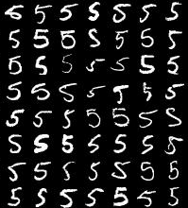
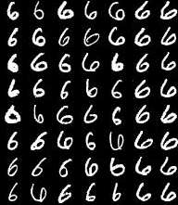
Naïve Bayes Training
Now that we’ve decided to use a Naïve Bayes classifier, we need to train it with some data:
MNIST Training Data

Slide 5
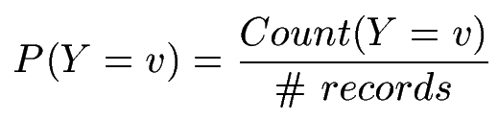

Naïve Bayes Training
Training in Naïve Bayes is easy:
Estimate P(Y=v) as the fraction of records with Y=v
Estimate P(X_{i}=u|Y=v) as the fraction of records with Y=v for which X_{i}=u
(This corresponds to Maximum Likelihood estimation of model parameters)

Slide 6
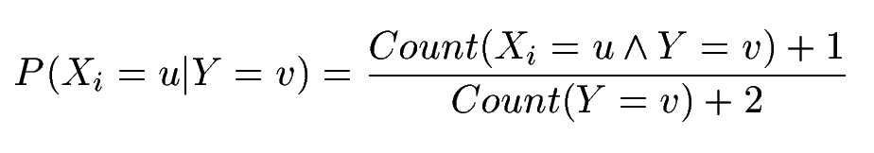
Naïve Bayes Training
In practice, some of these counts can be zero
Fix this by adding “virtual” counts:
(This is like putting a prior on parameters and doing MAP estimation instead of MLE)
This is called Smoothing

Slide 7
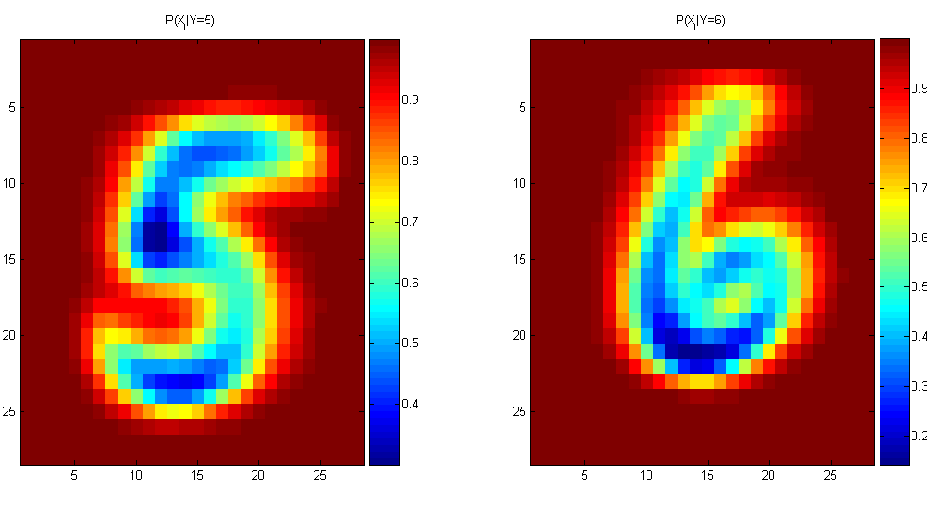
Naïve Bayes Training
For binary digits, training amounts to averaging all of the training fives together and all of the training sixes together.

Slide 8
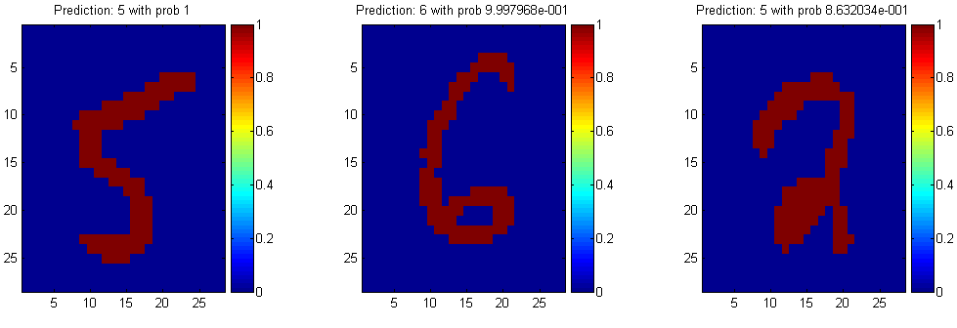
Naïve Bayes Classification

Slide 9
Another Example of the Naïve Bayes Classifier
The weather data, with counts and probabilities
outlook |  |  | temperature |  |  | humidity |  |  | windy |  |  | play
 | yes | no |  | yes | no |  | yes | no |  | yes | no | yes | no
sunny | 2 | 3 | hot | 2 | 2 | high | 3 | 4 | false | 6 | 2 | 9 | 5
overcast | 4 | 0 | mild | 4 | 2 | normal | 6 | 1 | true | 3 | 3
rainy | 3 | 2 | cool | 3 | 1
sunny | 2/9 | 3/5 | hot | 2/9 | 2/5 | high | 3/9 | 4/5 | false | 6/9 | 2/5 | 9/14 | 5/14
overcast | 4/9 | 0/5 | mild | 4/9 | 2/5 | normal | 6/9 | 1/5 | true | 3/9 | 3/5
rainy | 3/9 | 2/5 | cool | 3/9 | 1/5
A new day
outlook | temperature | humidity | windy | play
sunny | cool | high | true | ?

Slide 10
Likelihood of yes
Likelihood of no
Therefore, the prediction is No

Slide 11
The Naive Bayes Classifier for Data Sets with Numerical Attribute Values
One common practice to handle numerical attribute values is to assume normal distributions for numerical attributes.

Slide 12
The numeric weather data with summary statistics
outlook |  |  | temperature |  |  | humidity |  |  | windy |  |  | play
 | yes | no |  | yes | no |  | yes | no |  | yes | no | yes | no
sunny | 2 | 3 |  | 83 | 85 |  | 86 | 85 | false | 6 | 2 | 9 | 5
overcast | 4 | 0 |  | 70 | 80 |  | 96 | 90 | true | 3 | 3
rainy | 3 | 2 |  | 68 | 65 |  | 80 | 70
 |  |  |  | 64 | 72 |  | 65 | 95
 |  |  |  | 69 | 71 |  | 70 | 91
 |  |  |  | 75 |  |  | 80
 |  |  |  | 75 |  |  | 70
 |  |  |  | 72 |  |  | 90
 |  |  |  | 81 |  |  | 75
sunny | 2/9 | 3/5 | mean | 73 | 74.6 | mean | 79.1 | 86.2 | false | 6/9 | 2/5 | 9/14 | 5/14
overcast | 4/9 | 0/5 | std dev | 6.2 | 7.9 | std dev | 10.2 | 9.7 | true | 3/9 | 3/5
rainy | 3/9 | 2/5

Slide 13
Let x₁, x₂, …, x_{n} be the values of a numerical attribute in the training data set.

Slide 14
For examples,
Likelihood of Yes =
Likelihood of No =

Slide 15
Outputting Probabilities
What’s nice about Naïve Bayes (and generative models in general) is that it returns probabilities
These probabilities can tell us how confident the algorithm is
So… don’t throw away those probabilities!

Slide 16
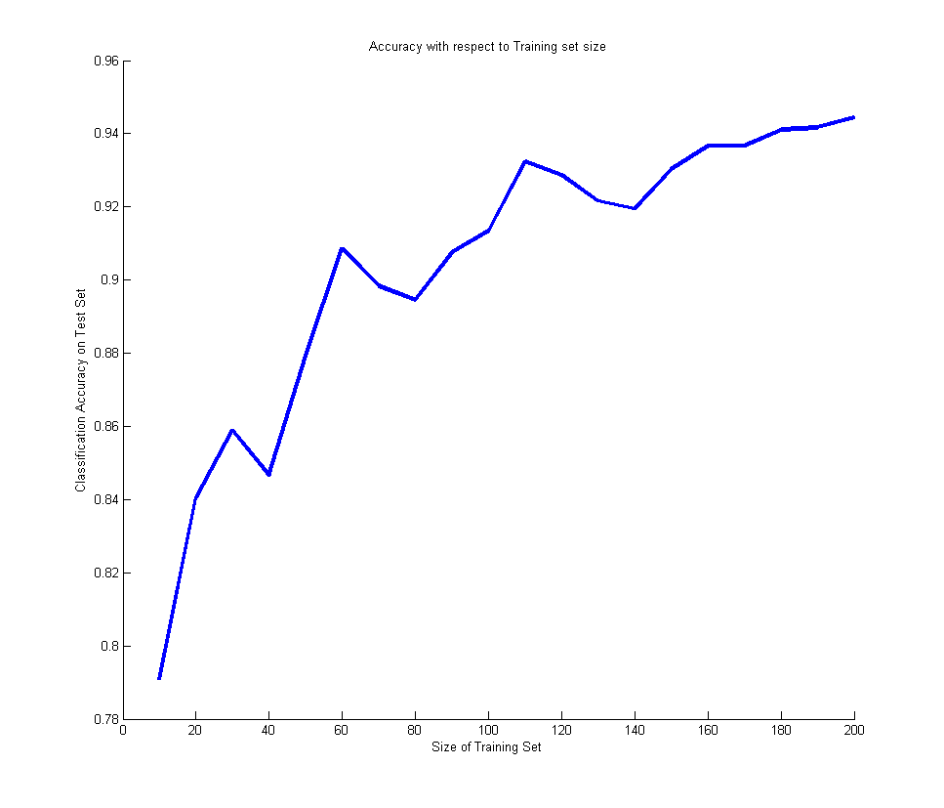
Performance on a Test Set
Naïve Bayes is often a good choice if you don’t have much training data!

Slide 17
Naïve Bayes Assumption
Recall the Naïve Bayes assumption:
that all features are independent given the class label Y
Does this hold for the digit recognition problem?

Slide 18
Exclusive-OR Example
For an example where conditional independence fails:
Y=XOR(X₁,X₂)
X₁ | X₂ | P(Y=0|X₁,X₂) | P(Y=1|X₁,X₂)
0 | 0 | 1 | 0
0 | 1 | 0 | 1
1 | 0 | 0 | 1
1 | 1 | 1 | 0

Slide 19
Actually, the Naïve Bayes assumption is almost never true
Still… Naïve Bayes often performs surprisingly well even when its assumptions do not hold

